Slide 1
Identifying potential business opportunities in the city of London
Pritika Sinha

Slide 2
Introduction
Post the certificate course in Coursera, I have now been equipped with the skills and the tools to use location data to explore a geographical location.
I have come up with a dummy business idea to leverage the Foursquare location data to explore neighbourhoods in a specific city of my choice.
I have identified a problem that I will use the Foursquare location data to solve.
The problem has been elaborated in the next slide.

Slide 3
Business Problem
An entrepreneur has recently relocated to London from New York.
He is looking to start a new venture but he is facing problems since
He is new to the city
He wants to learn about promising businesses and high demands.
He wants to base his judgements on an evidence based report.

Slide 4
Proposed Solution
As a business consultant, I have been assigned the duty of identifying promising business opportunity for this entrepreneur in the city of London.
I have been asked to submit a report and presentation highlighting my preferred choices for
Location options
Nature of Business

Slide 5
Approach
The approach I have undertaken is to dive deep into the various boroughs and neighbourhoods in London and identify
Various neighbourhoods
Profile of people and their preferences
Current existing businesses and their popularity
Promising business opportunity and locations

Slide 6
Target Audience
The target reader for this report is any individual/ businesses who are interesting in learning about the boroughs in London and one is particular which is Camden.
It explores the various venues and places of interest so the data can be useful to tourists or younger population that may be keen to learn more about this location and its hotspots.

Slide 7
Data – Source & Methodology
The data sources that I am using as a basis for my analysis are as below:
A list of London boroughs from the Wikipedia page. This data has been scraped and the link for the same is here
https://en.wikipedia.org/wiki/List_of_London_boroughs
Data fetched by sending messages (both regular and premium ) to the Foursquare API by using my client ID and client secret along with other mandatory fields like version and query type.
www.foursquare.com/api

Slide 8
Process Steps
Data Loading or Import
Data Cleansing
Data Manipulation
Data Extraction
Output Data
Final Files in the form of Tables, Visualization Maps and Reports

Slide 9
Key Steps
The detailed report is available for viewing in the Github repository.
This presentation will cover the key steps that are undertaken to reach the final recommendation.
The code for the same is also uploaded as a python file in the Github repository.

Slide 10
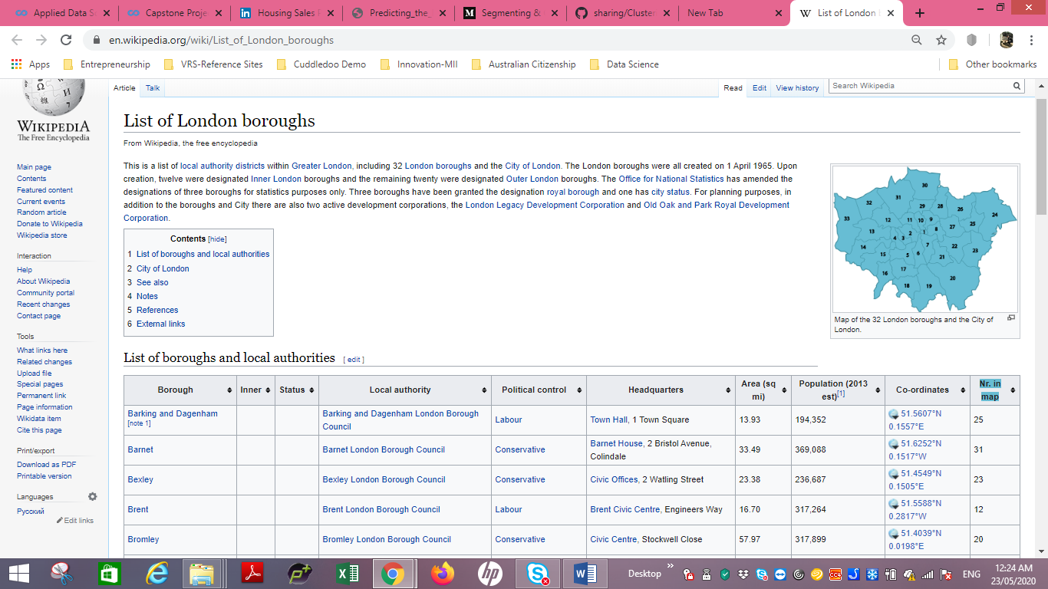
Fetching and importing Data

Slide 11
FOCUS AREA - CAMDEN
As discussed previously, I am interested in identifying business opportunities for an entrepreneur in London.
To narrow down on a specific neighbourhood, I have identified 'CAMDEN' to be unbeatable in its proximity, location, diversity and buzz.
It is a very famous and popular area with tourists, teenagers and punks. Hence we will now drill down and elaborate on this locality.

Slide 12
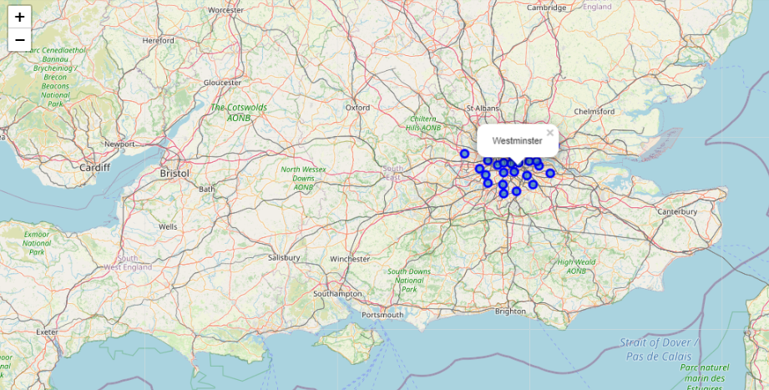
London City- Boroughs

Slide 13
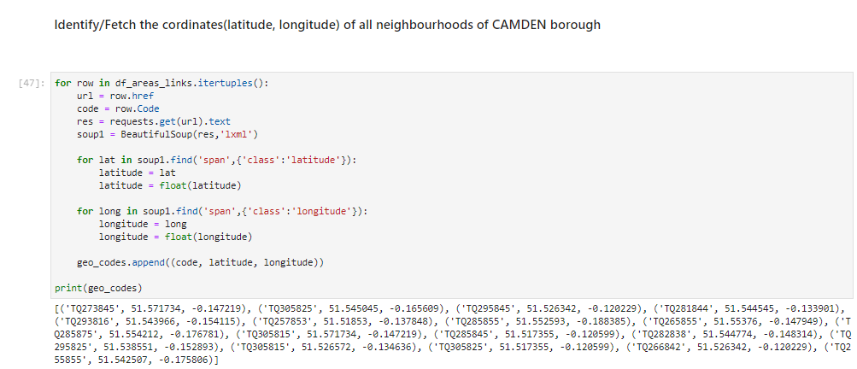
Fetching geo co-ordinates of all areas of Camden

Slide 14
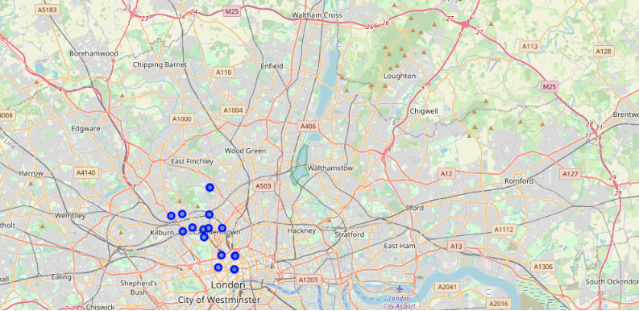
Camden Neighbourhoods Map

Slide 15
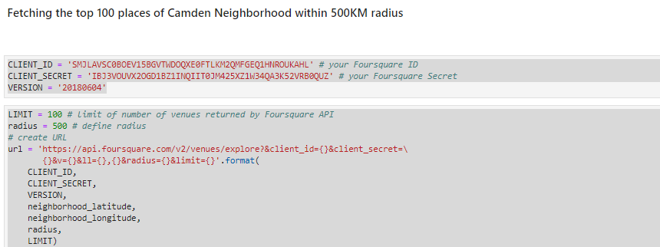
Identify Venues using Foursquare API

Slide 16
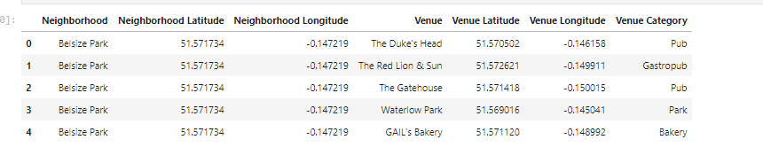
Fetching similar data for all neighbourhoods of ‘Camden’

Slide 17
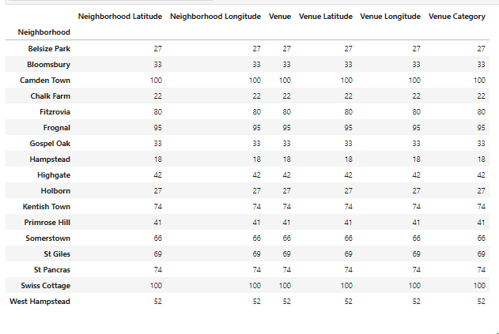
Display all venues by neighbourhood

Slide 18
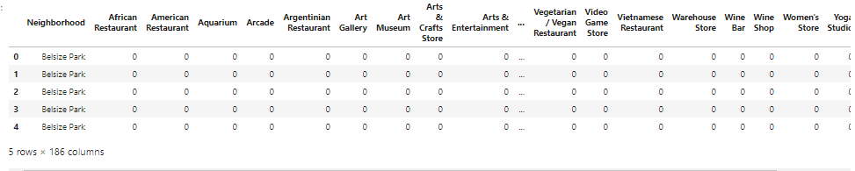
Analysing venue type for each neighbourhood

Slide 19
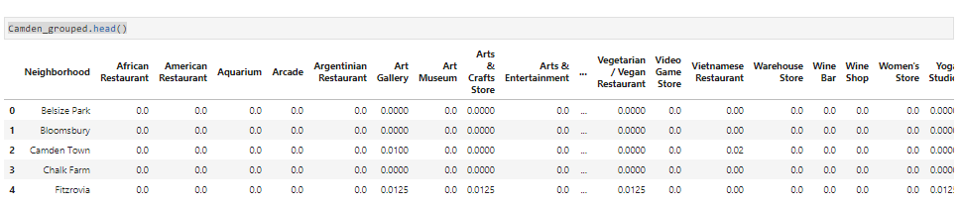
Run K-means cluster Algorithm on all neighbourhoods

Slide 20
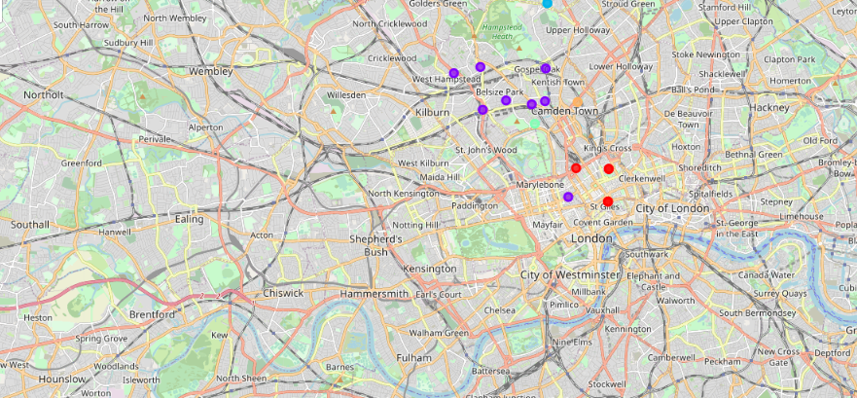
Visualize the clusters by plotting a map

Slide 21
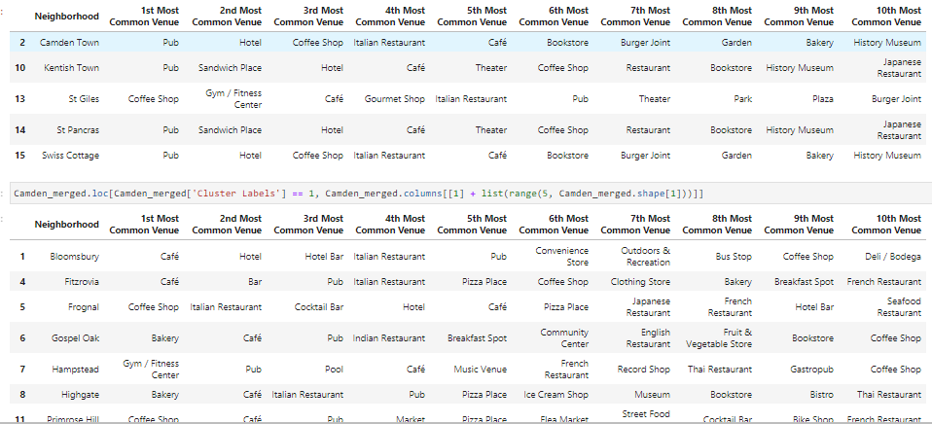
Examining the clusters(=0,1)

Slide 22
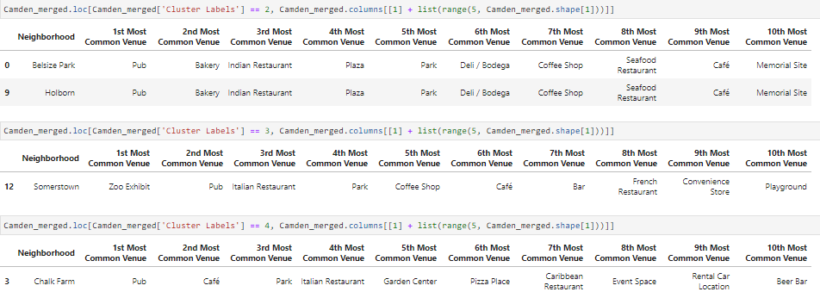
Examining the clusters(=2,3,4)

Slide 23
Cluster Analysis & Conclusion
After careful and detailed analysis of the data from the neighbourhoods, it has been identified that the neighbourhoods of Camden Town, Kentish Town,St. Pancras, Swiss Cottage, Belsize Park, Holborn and Chalk Farm have 'Pubs' as the most visited venue.
Since Camden borough is very popular among the youngsters and promotes punk culture, I have been successful in identifying a new business opportunity ,i.e. opening of a PUB.
The neighbourhood I have narrowed down to and identified is Camden Park since it is one of the most popular neighbourhoods of Camden and of London city. Camden has the seventh largest economy in the UK. The area's industrial economic base has been replaced by service industries such as retail, tourism and entertainment. The area now hosts street markets and music venues that are strongly associated with alternative culture.

